Slide 1
EE227 – Digital Logic Design
Lecture 27

Slide 2
Outline
BCD Decade Counter
Synchronous Counter
BCD Counter
4 bit Binary Counter with Parallel Load
Quiz 7

Slide 3
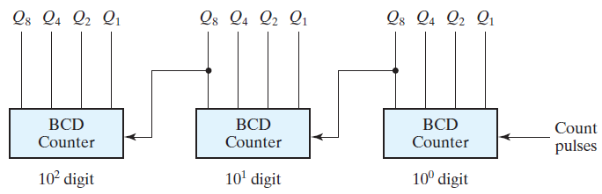
BCD Decade Counter
The BCD counter is a decade counter as it counts from 0 to 9
To count in decimal from 0 to 99, we need a two‐decade counter
To count from 0 to 999, we need a three‐decade counter
Multiple decade counters can be constructed by connecting BCD counters in cascade, one for each decade

Slide 4
Synchronous Counters
Synchronous counters are different from ripple counters in that clock pulses are applied to the inputs of all flip‐flops
A common clock triggers all flip‐flops simultaneously, rather than one at a time in succession as in a ripple counter

Slide 5
Synchronous BCD Counter (1/4)
A BCD counter counts in binary‐coded decimal from 0000 to 1001 and back to 0000
Because of the return to 0 after a count of 9, a BCD counter does not have a regular pattern, unlike a straight binary count
In a BCD counter we have an output y, which is equal to 1 when the present state is 1001
In this way, y can enable the count of the next‐higher significant decade while the same pulse switches the present decade from 1001 to 0000

Slide 6
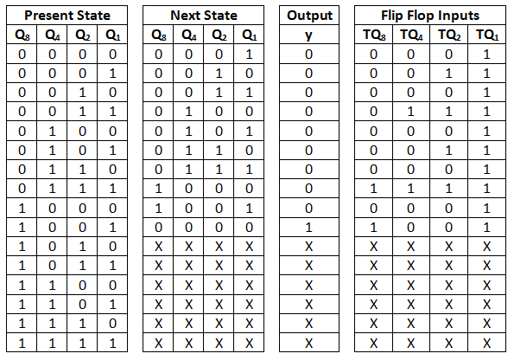
Synchronous BCD Counter (2/4)

Slide 7
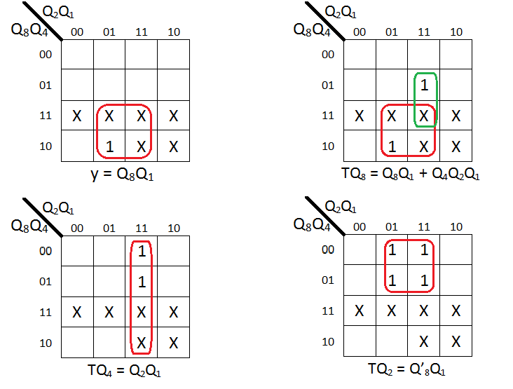
Synchronous BCD Counter (3/4)

Slide 8
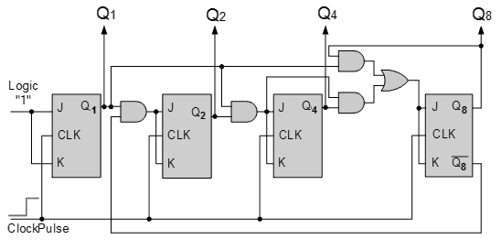
Synchronous BCD Counter (4/4)

Slide 9
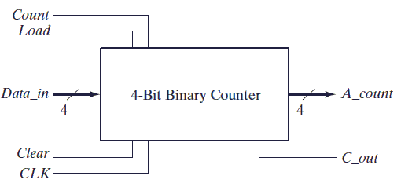
Binary Counter with Parallel Load
Counters employed in digital systems quite often require a parallel‐load capability for transferring an initial binary number into the counter prior to the count operation
The block diagram of a 4 bit binary counter with parallel load is shown below
The carry output becomes a 1 if all the flip‐flops are equal to 1 while the count input is enabled
The carry output is useful for expanding the counter to more than four bits

Slide 10
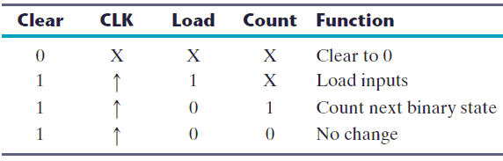
Binary Counter with Parallel Load
The operations of a 4 – bit binary counter with parallel load is summarized in the table below

Slide 11
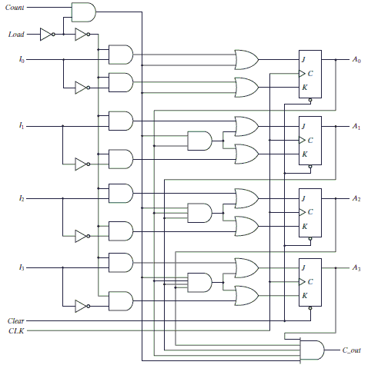
Binary Counter with Parallel Load

Slide 12
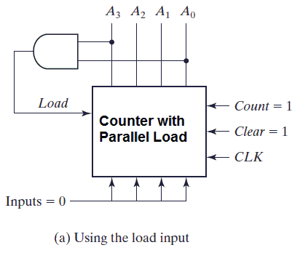
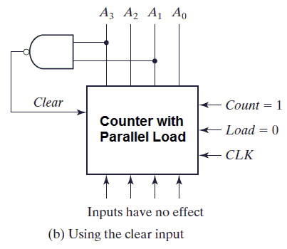
Uses of Binary Counter with Parallel Load
A counter with a parallel load can be used to generate any desired count sequence
Using as a BCD counter

